Slide 1
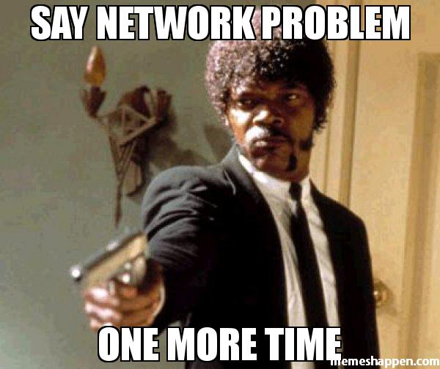
Networks - data plumbing

Slide 2

Web – communicating with consumers

Slide 3

App - where your business logic might be

Slide 4
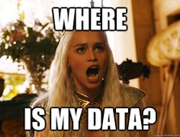
Storage - where you probably persist data

